Slide 1
Folksonomies - Cooperative Classification and Communication Through Shared Metadata
Adam Mathes
University of Illinois Urbana-Champaign
Computer Mediated Communication - LIS590CMC DEC/2004
July 1, 2011
Heegook Jun

Slide 2
Outline
The Creation of Metadata
Tagging Content in Del.icio.us and Flickr
From Tags to Folksonomy
Why Folksonomies Work
Area For Further Research
Conclusion

Slide 3
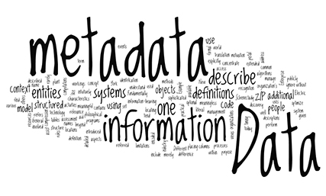
The Creation of Metadata
Metadata
Data about data
Highly structured: doc, book, article, photograph..
Facilitate access of information
Creation of Metadata: Professionals
Creation of Metadata: Content Creators
Creation of Metadata: Users

Slide 4


Metadata by Professionals
Traditional way
MARC(Machine-Readable Cataloging) FORM
Basis of OPAC(Online Public Access Catalogs)
For high Quality metadata
It is costly in terms of time and effort to produce
Requires serious education and training
Hard to keep up with the vast amounts of content (www)

Slide 5
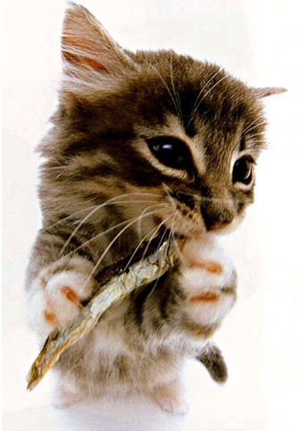
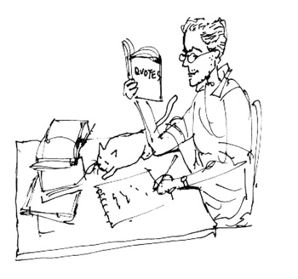
Metadata by Content Creators
Original creators of content provide metadata
The Dublin Core Metadata (success in this area)
May help with the scalability problems
Inadequate or inaccurate description or outright deception
By professionals and content creators
Users information are disconnected from the process
Notes:
고양이에 생선 맡기기

Slide 6

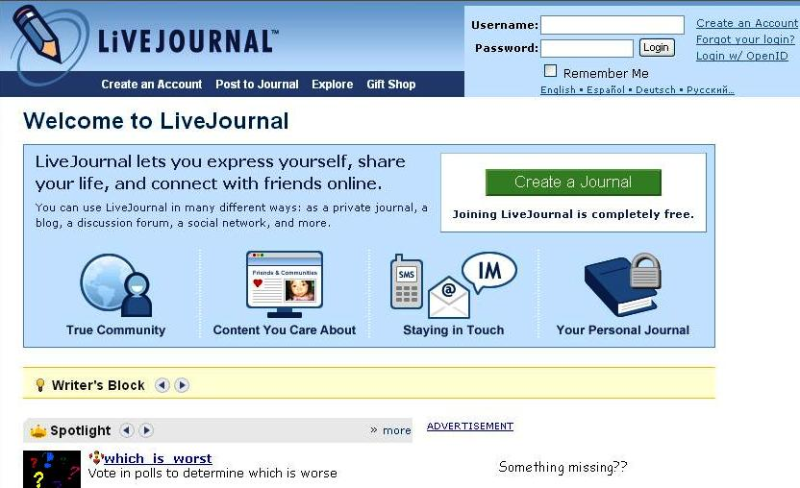
Metadata by Users
Users create metadata
for their own individual use
shared throughout a community
Implicit user created metadata
PageRank algorithm
Recommendation systems, collaborative filtering
Explicit user created metadata
Weblog in the late 1990’s
Link-focused website

Slide 7
Outline
The Creation of Metadata
Tagging Content in Del.icio.us and Flickr
From Tags to Folksonomy
Why Folksonomies Work
Area For Further Research
Conclusion

Slide 8
Tagging Content in Del.icio.us and Flickr
Del.icio.us
Social bookmarks manager
Add sites to users personal collection of links
Categorize with keywords
Share users collection
Flickr
Free-form tagging for photos
Primary difference
Tags on Delicious are primarily for others web doc
Tags on Flickr are primarily for themselves (not absolute)

Slide 9
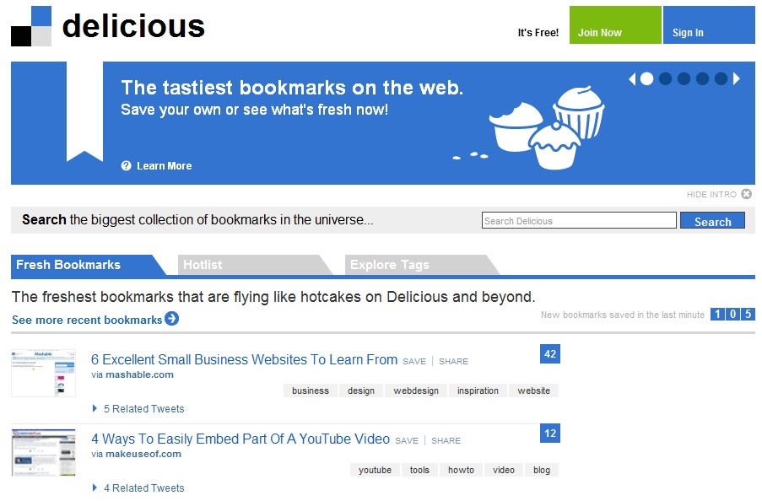
Delicious

Slide 10
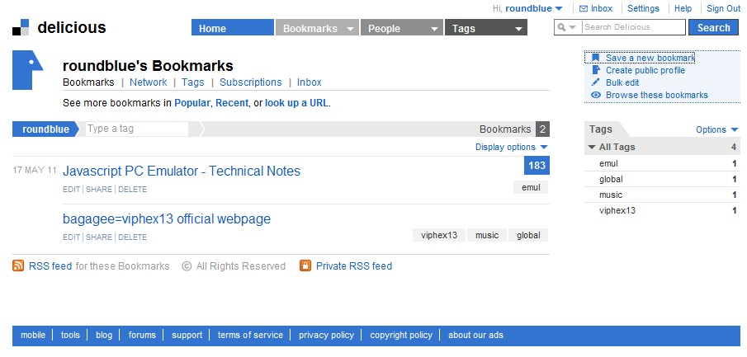
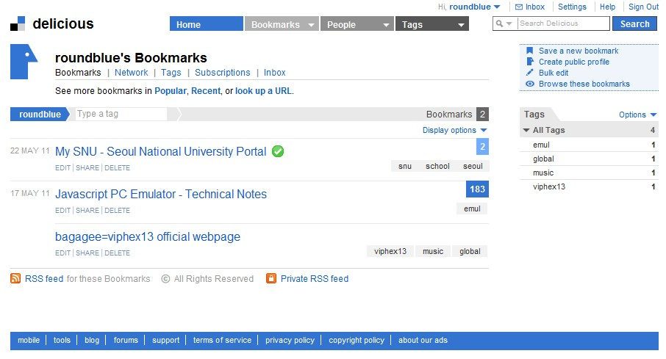
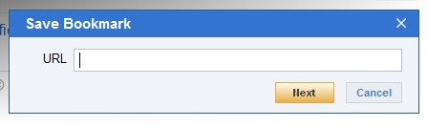
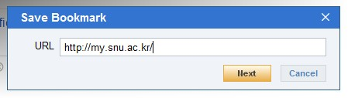
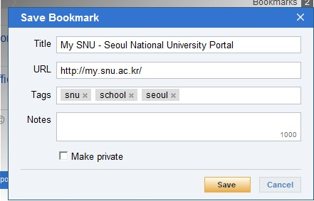
Delicious

Slide 11
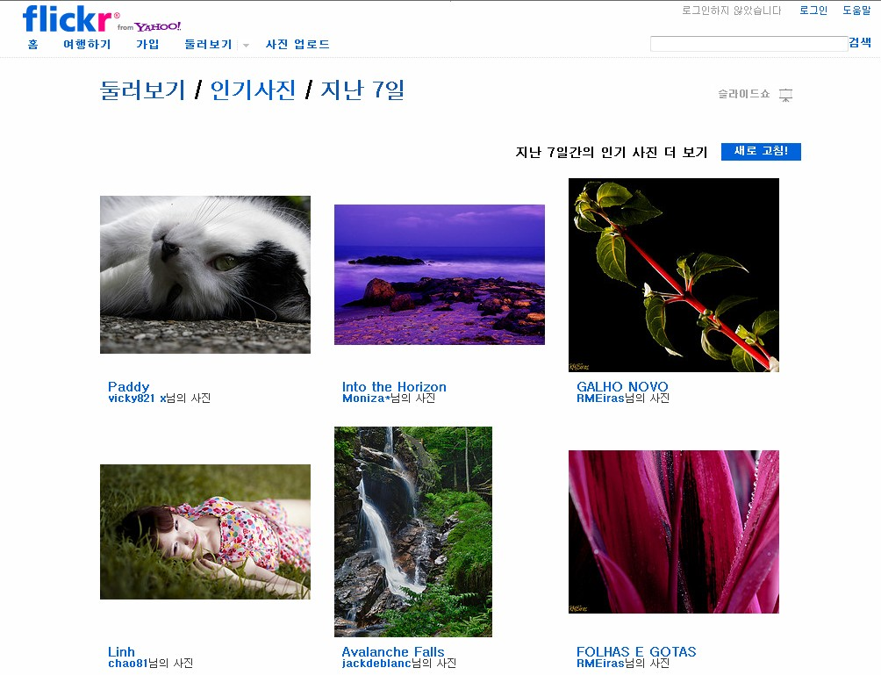
Flickr

Slide 12
Outline
The Creation of Metadata
Tagging Content in Del.icio.us and Flickr
From Tags to Folksonomy
Why Folksonomies Work
Area For Further Research
Conclusion

Slide 13
From Tags to Folksonomy
Folksonomy
Limitations
Ambiguity
Spaces, Multiple Words
Synonyms
Browsing vs. Finding
Desire Lines

Slide 14
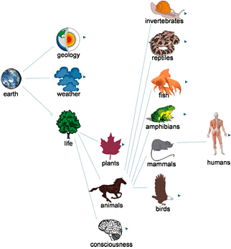
1/7 Folksonomy
“Folk” + “Taxonomy”
“Folk”: done by people
“Taxonomy”: a classification of items into groups based on similarities of structure or origin
Thomas Vander wal in a discussion on mailing list

Slide 15
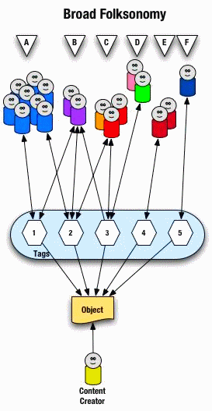
1/7 Folksonomy
A way to organize and share contents
Tagging resources
Synonyms: ethnoclassification, collaborative tagging

Slide 16
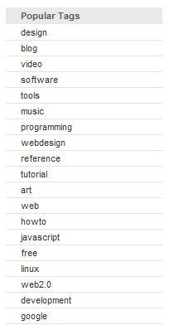
1/7 Folksonomy: In Delicious
Most popular tags: subject descriptor keywords
Software, design, programming, music, politics, web..
Genre or form descriptors
Comics, humor, fun, photography
Something qualitatively different
“toread”, “wishlist”

Slide 17
1/7 Folksonomy: In Flickr
Most popular tags: common subjects of photos
cat, friends, dog, sky, sea, park, kids, ..
Over 20% of the tags
proper place names: cities, countries
colors: red, blue, pink, ..
years: 2001, 2002, 2003, ..

Slide 18

1/7 Folksonomy: In Flickr

Slide 19
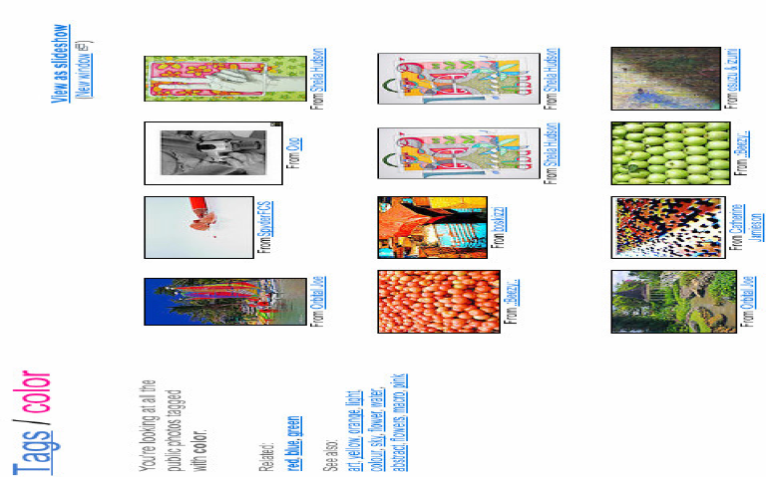
1/7 Folksonomy: In Flickr

Slide 20
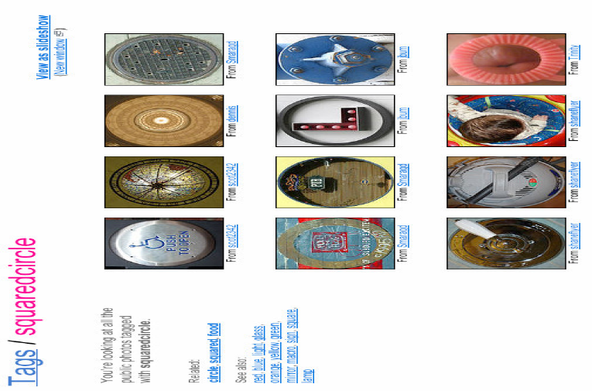
1/7 Folksonomy: In Flickr

Slide 21
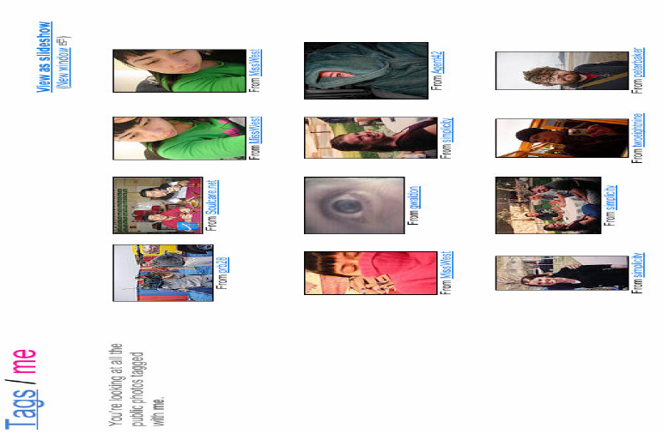
1/7 Folksonomy: In Flickr
Particular term about photographic domain
Cameraphone, fotolog.. (reflect new technology)
Reflect compulsion to share & individuality(ego)
“cute”, “me”

Slide 22
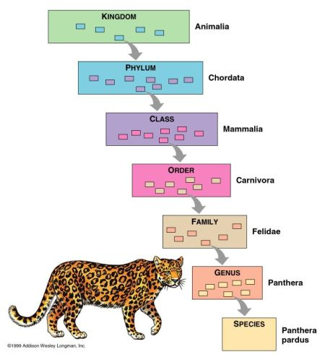
1/7 Folksonomy vs Taxonomy
Flat
No levels, order, explicit relationship
Not Exclusive
item can be associated to many tags
Bottom-up
Created by users
“Categorization”
Hierarchical
Parent/child & sibling relationship
Exclusive
The same item can’t be in two distinct categories
Top-down
Established by an authority
“Classification”

Slide 23



2/7 Limitations
Uncontrolled vocabulary lead to a number of limitations
Ambiguity
Polisemy (same tag used with different meaning)
Synonyms (different tags with the same meaning)
Plural & Singular
Acronyms(이니셜)
Formatting of terms
Spaces, multiple words

Slide 24
2/7 Limitations
Tag Language
Different languages for the same tag
Shortsighted
Fail to capture the “big picture”
Too little formal structure
No relationship between related tags

Slide 25
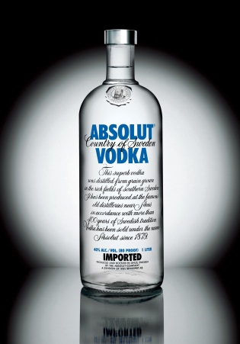
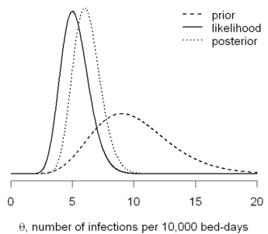
3/7 Ambiguity
As an uncontrolled vocabulary
No explicit systematic guidelines
Different users apply terms in different ways
Items tagged with “filtering” on Delicious
Oh My God It burns – for drunks. Brita filter makes vodka..
Introduction to bayesian filtering
Acronyms
“ANT”: Actor Network Theory
“ANT”: Apache Ant (java programing project)

Slide 26
4/7 Spaces, Multiple Words
Delicious & Flickr designed to deal with single words
Single tag without spaces
(not strickly on flickr)
Vertigo video stills bbc → “vertigovideostillsbbs”
Ignore letter case
It may collapse distinct ideas: a, s, 1, …

Slide 27

5/7 Synonyms
No synonym control in the system
“mac”, “macintosh”, “apple”, ..
Plural and singular
Book/books, like/likes
Delicious provides “related tags” sidebar
Interlinks these categories automatically

Slide 28


6/7 Browsing vs. Finding
Finding
looking for answers to specifically formulated questions
Browsing
exploring a problem space to formulate questions
Fosters serendipity
Chance to explorer unexpected authors and sites

Slide 29

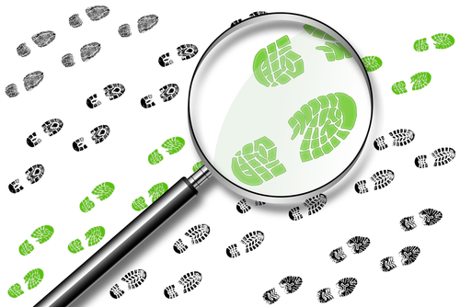
7/7 Desire Lines
“foot-worn paths that sometimes appear in a landscape over time” - Peter Merholz (2004)
“A smart landscape designer will let wanderers create paths through use, and then pave the emerging walkways, ensuring optimal utility. Ethnoclassification systems can similarly emerge”
Folksonomy can be quite useful
in that it reveals the digital equivalent of “desire lines”
Notes:
쓸사람이 직접 다니기 쉬운곳을 다니다가 길이 생기도록

Slide 30
7/7 Desire Lines
Merholsz prefered Ethnoclassification
Doesn’t use folksonomy
Recommends it as the start of professionally designed controlled vocabularies
Inaccurate
Folksonomy is more like categorization than classification

Slide 31
1/7 Folksonomy
“Folk” + “Taxonomy”
“Folk”: done by people
“Taxonomy”: a classification of items into groups based on similarities of structure or origin
Thomas Vander wal in a discussion on mailing list
A way to organize and share contents
Tagging resources
Synonyms: ethnoclassification, collaborative tagging

Slide 32
7/7 Desire Lines
Merholsz prefered Ethnoclassification
Doesn’t use folksonomy
Recommends it as the start of professionally designed controlled vocabularies
Inaccurate
Folksonomy is more like categorization than classification

Slide 33
1/7 Folksonomy vs Taxonomy
Flat
No levels, order, explicit relationship
Not Exclusive
An item can be associated to many tags
Bottom-up
Created by users
“Categorization”
Hierarchical
Parent/child & sibling relationship
Exclusive
The same item can’t be in two distinct categories
Top-down
Established by an authority
“Classification”

Slide 34
7/7 Desire Lines
But, in Delicious, his article tagged with
“ethnoclassification”, “folksonomy”, “tagging”, “taxonomy”..
The tags reflect
not the author’s or any particular system’s vocabulary,
but the users choose to describe the article with

Slide 35
Outline
The Creation of Metadata
Tagging Content in Del.icio.us and Flickr
From Tags to Folksonomy
Why Folksonomies Work
Area For Further Research
Conclusion

Slide 36
Why Folksonomies Work
Hard to define whether folksonomies are a success or failure
It seem to be effective as organizing information
And Important: large group of people are using it
Barriers to Entry, Cognitive Costs
Feedback and Asymmetric Communication
Individual and Community Aspects
Unanticipated Uses

Slide 37
1/4 Barriers to Entry, Cognitive Costs
It is far easier: time, effort and cognitive costs
Cheap and easy way to classify
Stewart Butterfield, one of the creators of Flickr
Free typing loose associations is just a lot easier than making a decision about the degree of match to a pre-defined category.
It’s like 90% of the value of a proper taxonomy but 10 times simpler

Slide 38

2/4 Feedback and Asymmetric Communication
Assignment of tags in a tight feedback loop
It leads to asymmetric communication
Immediate Feedback
You can adapt to the group norm
keep your tag in a bid to influence the group norm
(or both)
Users are negotiating the meaning of the terms in the folksonomy

Slide 39

3/4 Individual and Community Aspects
Individual Purpose
Tag materials to find these items later
“me” tag on Flickr
“toread” tag on Delicious
Community Aspects
Delicious and Flickr are services designed to share
Users can also be thought of as being influenced and related to their relationship to the other individuals using the service

Slide 40
3/4 Individual and Community Aspects
Lowers the barriers to cooperation
Users only need to agree on the “meaning” of a tag
Tight feedback loop provides incentives for this cooperation
Community & individual motivations are not mutually exclusive
Both are necessary to explain a folksonomy

Slide 41
4/4 Unanticipated Uses
Tags being used in some unexpected, interesting ways
Communication group formation through metadata
Flickr’s “sometaithurts” for so meta it hurts

Slide 42
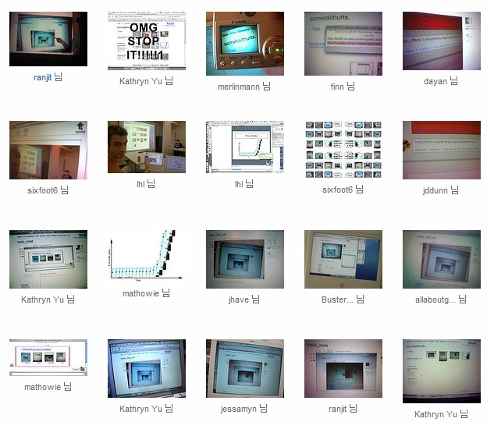
4/4 Unanticipated Uses

Slide 43
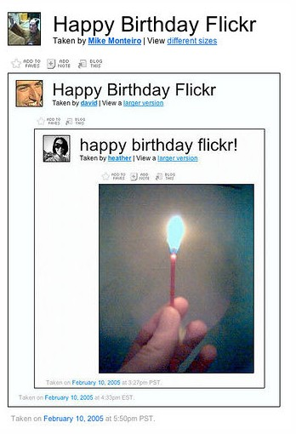
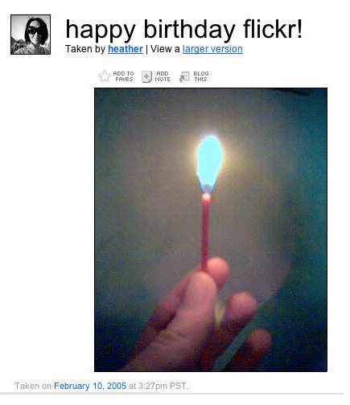
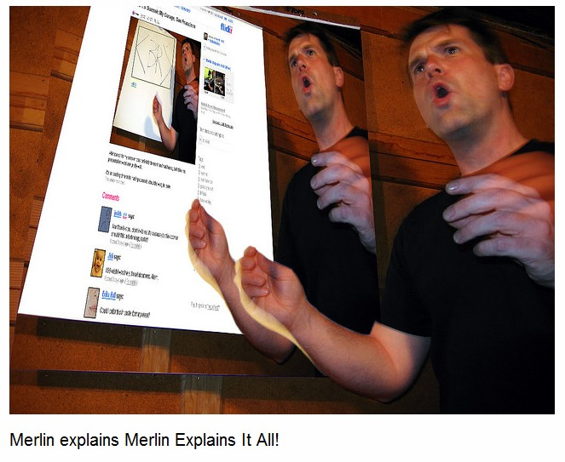
4/4 Unanticipated Uses

Slide 44
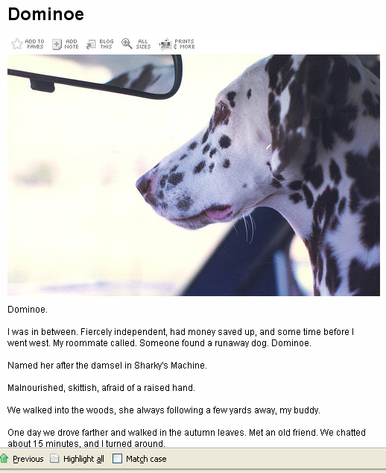
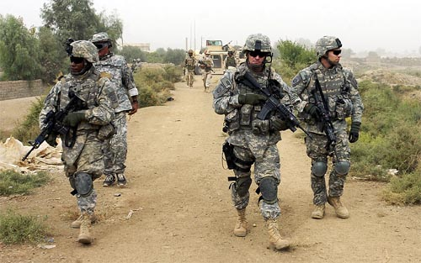
4/4 Unanticipated Uses
New terms to describe what is going on
And others adopting that term and the activity it describes
“Flicktion: photo + short story” Andrew Lowosky
Group of people helping to define a term with their photographs and metadata (may not a community)
“iraq”: US troops in Iraq, war protest

Slide 45
Outline
The Creation of Metadata
Tagging Content in Del.icio.us and Flickr
From Tags to Folksonomy
Why Folksonomies Work
Area For Further Research
Conclusion

Slide 46
Areas For Further Research
Quantitative Tag Analysis
Hypothesize that it follows a power law scenario
The most used tags are more likely to be used by other users
Qualitative User Analysis
Ethnographic observation
How individual incentives and group communication motivations influence use of the system
Applicability to other systems
How Social network related to the system
Academic use
Research and information retrieval system

Slide 47

Conclusion: Folksonomy
Created by Users (Bottom up)
No Structure
No fixed vocabulary
No explicit relationships between terms
No authority
Distribution
Collaboration

Slide 48
Conclusion: Benefits
Cheap and easy way to classify
Capable to adapt very quickly to changes and user needs
Reflects the vocabulary of users
Fosters serendipity (browsing vs finding)
Lowers the barriers to cooperation
Facilitate communication through metadata

Slide 49
Conclusion: Limitations
Ambiguity
Polisemy (same tag used with different meaning)
Synonyms (different tags with the same meaning)
Plural & Singular
Acronyms
Formatting of terms
Spaces, multiple words
Shortsighted
Fail to capture the “big picture”
Too little formal structure
No relationship between related tags
Notes:
Polisemy: 배
Synonyms: Mac, apple
Acronyms: 이니셜
Tag Language

Slide 50
Conclusion
Folksonomy represents the best and worst in the organization of information
creation of metadata for resources
from an isolated, professional activity
to a shared, communicative activity by users
important development that should be explored and considered for future systems development

Slide 51
Thank You!
Any Questions or Comments?

